Slide 1
CBAM IT System Overview
ECCG &TCG meeting March 2023

Slide 2
CBAM Scope and Impact
The Carbon Border Adjustment Mechanism was proposed as part of ‘Fit for 55 Package’ in July 2021. The Trilogue on the CBAM draft Regulation concluded in December 2022. CBAM regulation to be adopted in Q2 2023
CBAM introduces significant new measures for
Importers/Declarants of CBAM goods
EU Authorities in charge of CBAM
Commission
MS Customs Administrations

Slide 3
CBAM Deployment Phases
CBAM Phase 1: Transitional Period from the 4th quarter of 2023 until 31st December 2024 covering the CBAM Reports;
CBAM Phase 2: Transitional Period augmented with the Authorization of CBAM Declarants and Registration of Operators and Installations from 3rd Countries as from 31 December 2024 until 31st December 2025;
CBAM Phase 3: Definitive Period from 1st quarter 2026.

Slide 4
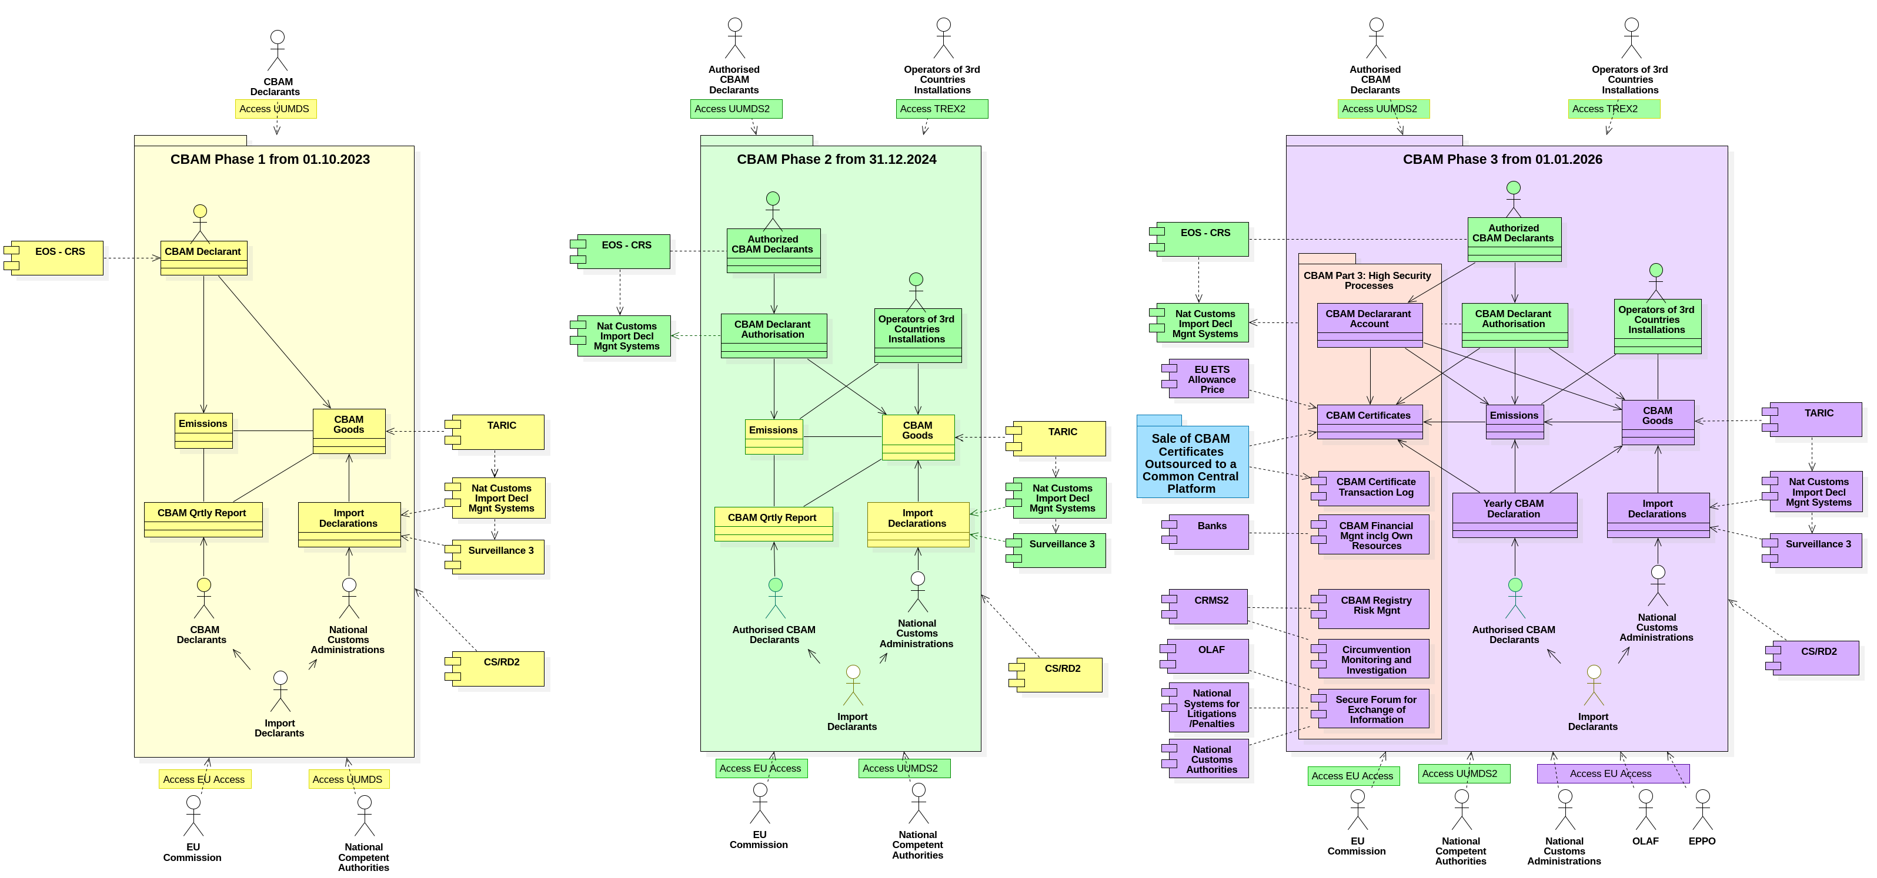
CBAM Deployment Phases

Slide 5
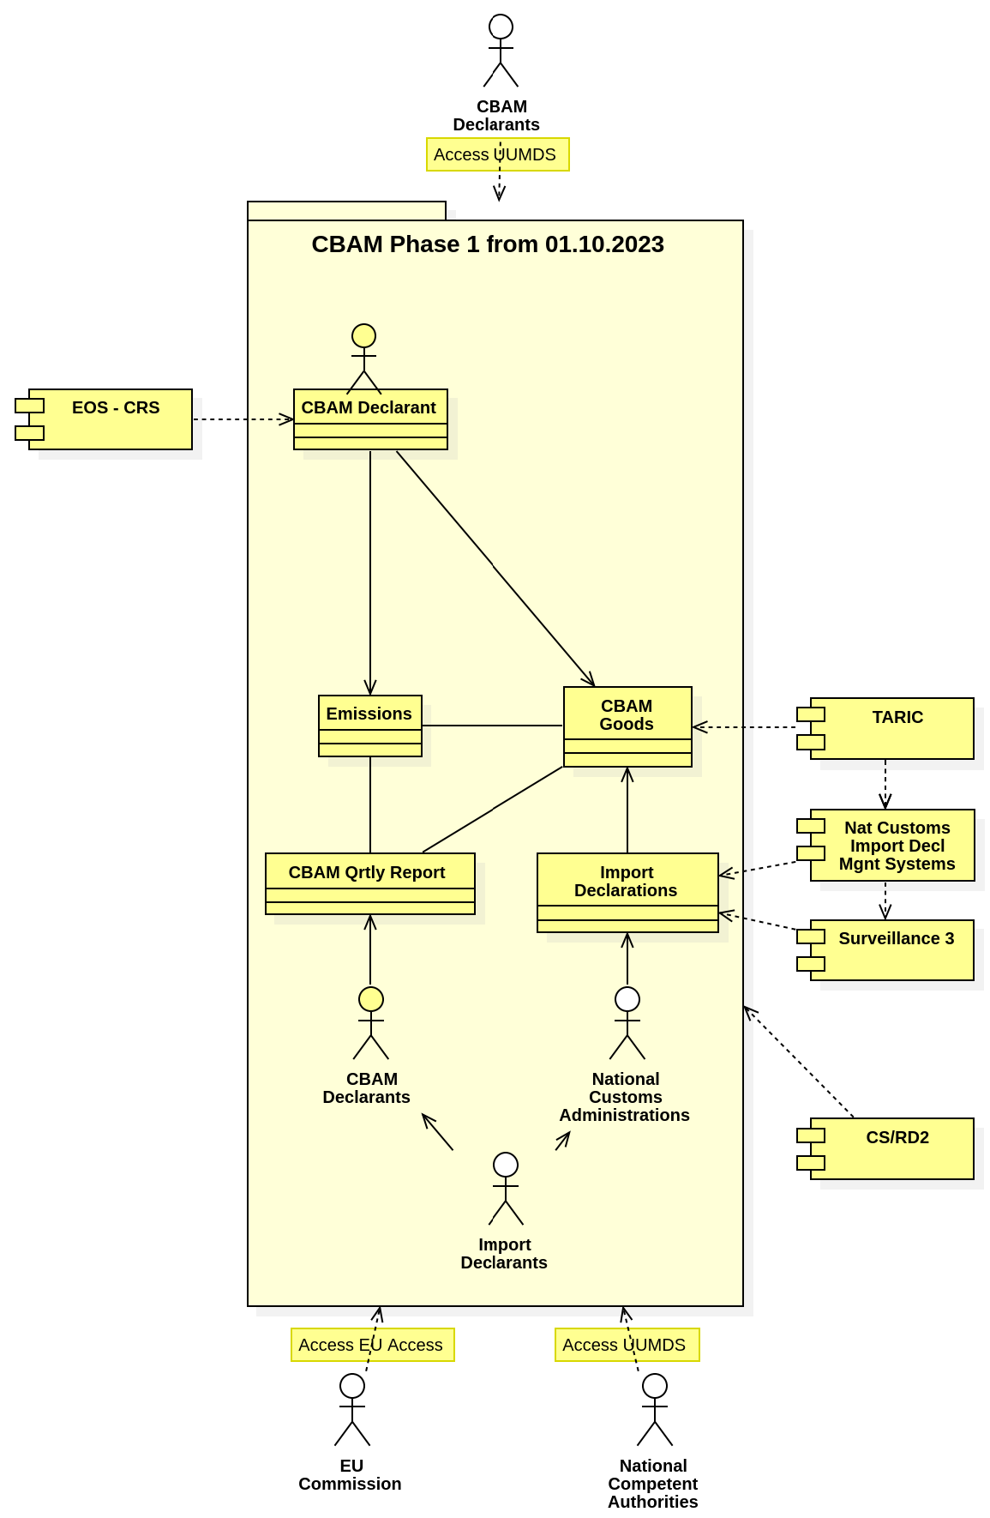
CBAM Transitional System- Phase I
CBAM introduces measures for the Importers, for the EU Authorities in charge of CBAM, the Commission and the MS Customs Administrations:
Importers have to file CBAM Periodic Reports to the CBAM system
Commission services will supervise and coordinate CBAM system operations and compliance to the provisions of the CBAM regulation
MS Customs Administrations will notify EO for their obligations arising from CBAM Regulation and report the imports of CBAM products of a specific period via the existing Surveillance 3 or other temporary means in case of derogation
MS Competent Authorities for CBAM will be responsible for CBAM EO Accounts management and will collaborate with Customs and Commission services to ensure compliance to the provisions of the CBAM regulation

Slide 6
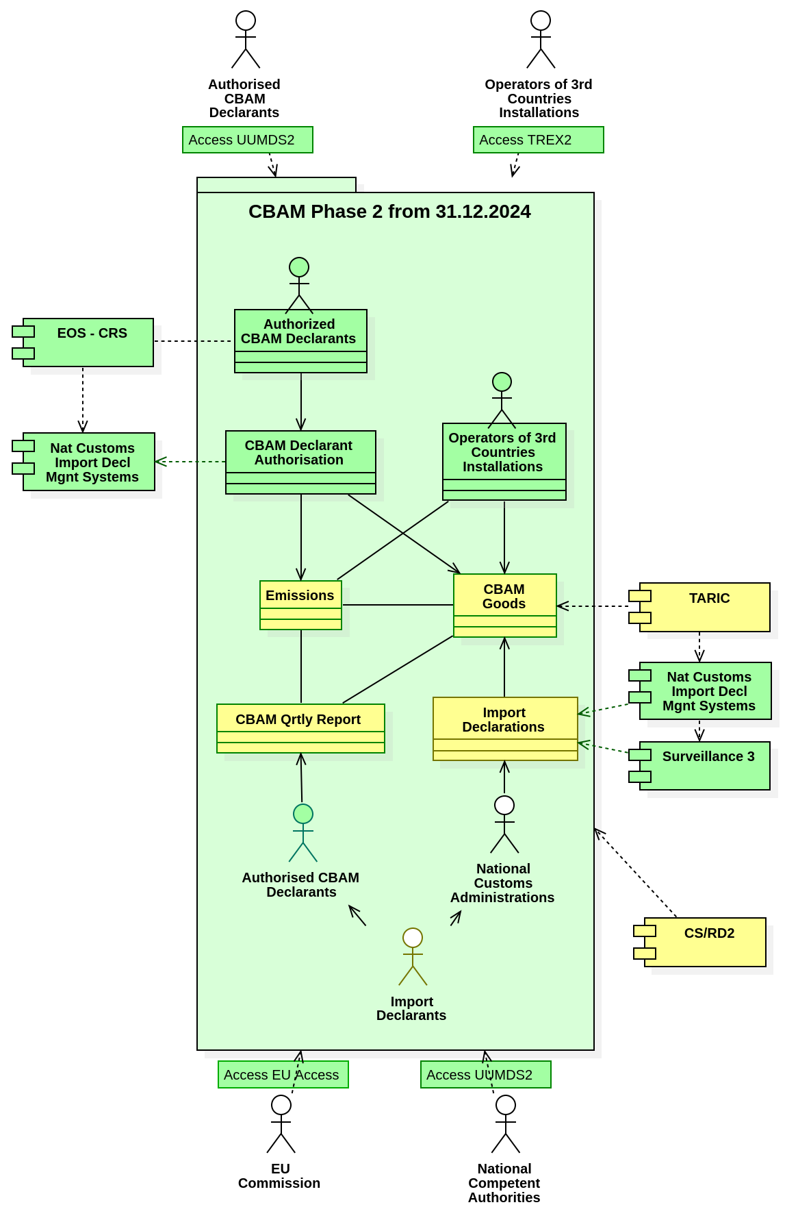
CBAM Transitional System- Phase II
The second part of CBAM will be deployed to operations including the following services:
• The CBAM central system should allow EU Economic Operators in their role of declarant for Import to apply for a CBAM Authorisation which EU Competent Authorities will validate and monitor through their lifecycle including granting the authorisation, assessing the use of the authorisation and even deciding to revoke an authorisation if the authorised declarant does not comply to his obligations. All authorisations will be registered in the CBAM registry.
• The CBAM central system should allow operators of production installations in third countries to register in the CBAM registry and to make their verified embedded GHG emissions from production of goods available to authorised CBAM declarants. The Commission should manage the CBAM registry containing data on the authorised CBAM declarants, operators and installations in third countries.

Slide 7
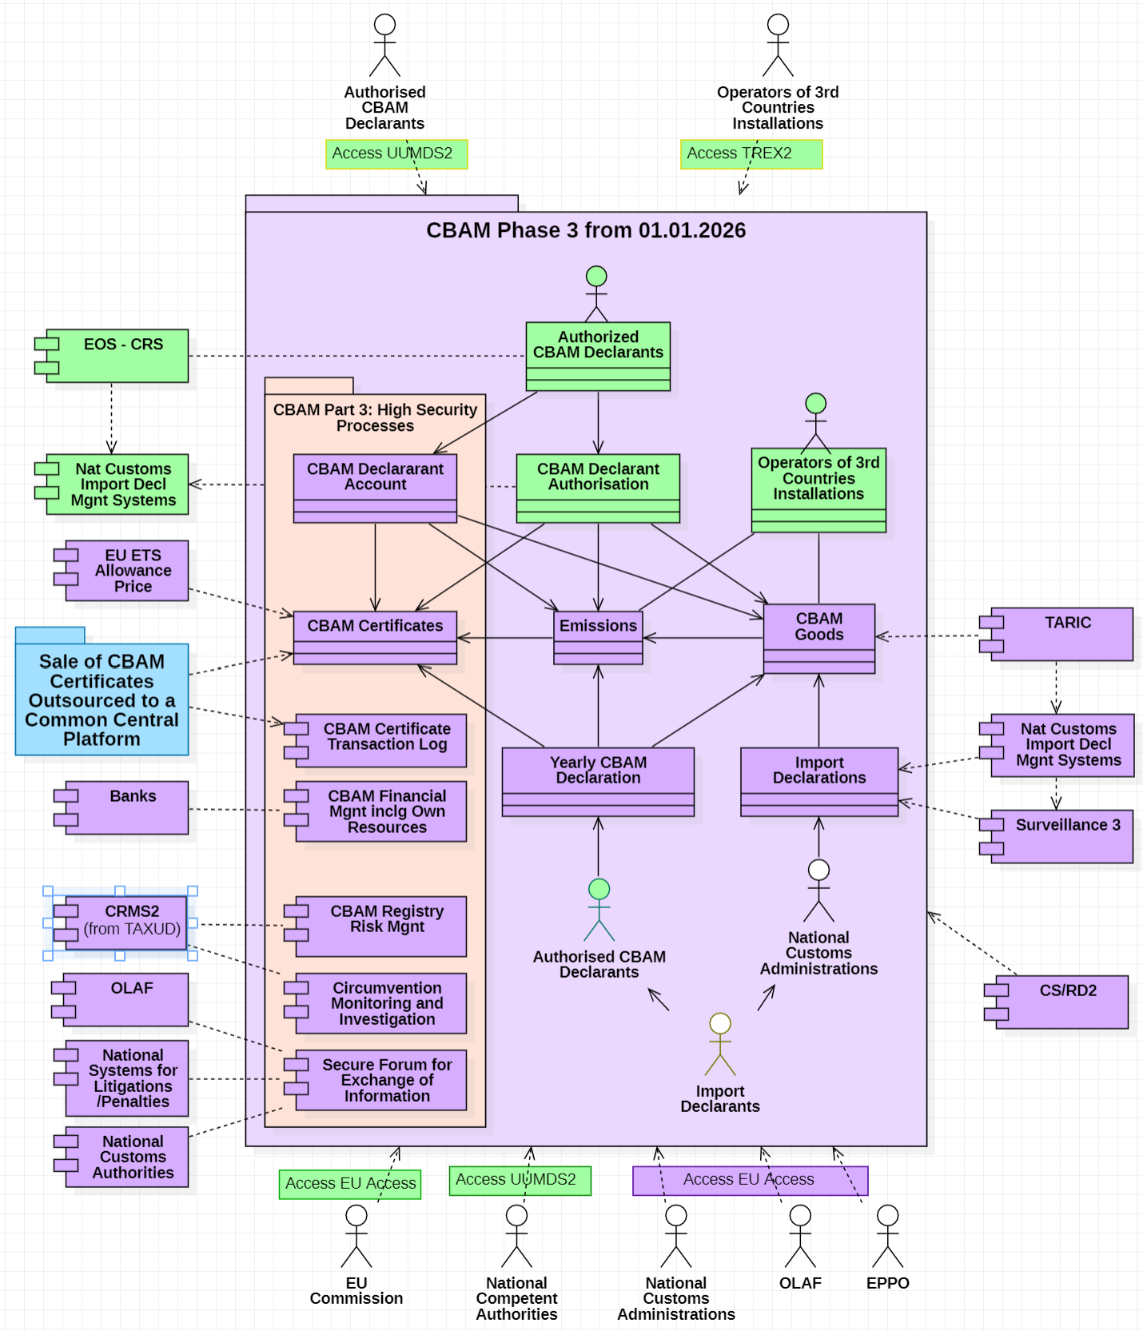
CBAM Transitional System- Phase III
Declarants of Imports of CBAM goods must hold a CBAM authorisation to import CBAM goods
Customs authorities must only allow the importation of CBAM goods of authorised CBAM declarants
Customs authorities should carry out controls on Import for CBAM purposes applying common risk criteria
The authorised CBAM declarant submits annually a declaration of the embedded emissions in the goods imported and surrenders a number of CBAM certificates corresponding to those declared emissions.
An authorised CBAM declarant should be allowed to claim a reduction in the number of CBAM certificates for the carbon price paid elsewhere for those emissions
To reduce the risk of carbon leakage the Commission should take action to address practices of circumvention.
For the sale and re-purchase of CBAM certificates a common central platform should be established
The COM should review the content of the CBAM declarations and involve MS in controls.
MS should be responsible for the correct establishment and collection of revenues

Slide 8
CBAM Timeline
CBAM Phase 1 enters in operations in Q1 2023
Customs must notify importers of CBAM goods for their obligations for CBAM
A collaboration framework should be established between Customs Authorities and CBAM Competent authorities at National Level
Importers of CBAM goods must be registered in CBAM in Q4 2023
Imports of CBAM Goods of the 4th quarter of 2023 must be shared with CBAM

Slide 9
CBAM Deliverables Planning
The following CBAM deliverables will be shared with the MSs for review
CBAM Deliverable | Date of Publication for review
Technical System Specifications | April
User Manual for CBAM Declarants | July
User Manual for Competent Authorities | July

Slide 10
CBAM Governance process
CBAM Project Charter for Phase 1 validated in Q4 2022-Q1 2023
CBAM Project has been introduced in MASP-C
CBAM Project Charter for Phase 2 and 3 will be submitted for validation in Q2 2023
A CBAM Expert Group has been set to collaborate with COM on CBAM
MS should appoint CBAM Competent Authorities in Q2 2023
The CBAM Steering Governance Organization will be set in Q2 2023

Slide 11
Key Points from CBAM Project Charter Validation by ECCG
All MS validated CBAM Project Charter in Q1 2023
DK,PL,PT,SE raised some important points for further analysis and consideration
Sharing of Data of Central Customs Systems with CBAM – Data Protection
Role of Customs for CBAM
Notification of Importers for CBAM Reporting
Impact of CBAM on NIS
MS Derogations and Data availability in SURV3 for CBAM
Access Management for CBAM

Slide 12
Sharing Customs Data with CBAM – Data Protection
Data from the following systems should be shared with CBAM and Data Protection provisions will be extended to this scope and appropriate references and empowerment will be included in CBAM IA
EO Record from EOS via CRS
Reference Data via CSRD2
Import Declaration Data through SURV3 / MS Temporary means
Taric Data through TARIC
Risk Profiles and Intelligence through CRMS2
Identification Data through UUM&DS
CBAM Authorization Data to NIS through CRS

Slide 13
Notification of Importers for CBAM Reporting
CBAM Importers list to submit periodic CBAM reports will be built by means of their Import declarations they filled in the previous quarter of the Transitional Period using also the SURV3 system or temporary means for countries not completing their migration of UCC import systems for all EO and integration with SURV3
For Goods under CBAM Specific measures should be foreseen in TARIC allowing Customs authorities to notify Importers for their obligations to file periodically their CBAM quarterly Reports in the central CBAM platform.

Slide 14
Access Management for CBAM
CBAM Importers will be identified using their EORI number
UUM&DS will be the platform enabling access to CBAM central platform for
Economic Operators
Commission users
MS Competent Authorities Users
MS should decide if MS Customs or other Competent Authorities will manage the EO accounts and authorisations for CBAM using the existing federation scheme or registering centrally the user accounts and manage the authorisations
MS will appoint competent authorities for CBAM purposes which could be Customs or other National Authorities following the formal adoption of the Regulation in Q2 2023

Slide 15
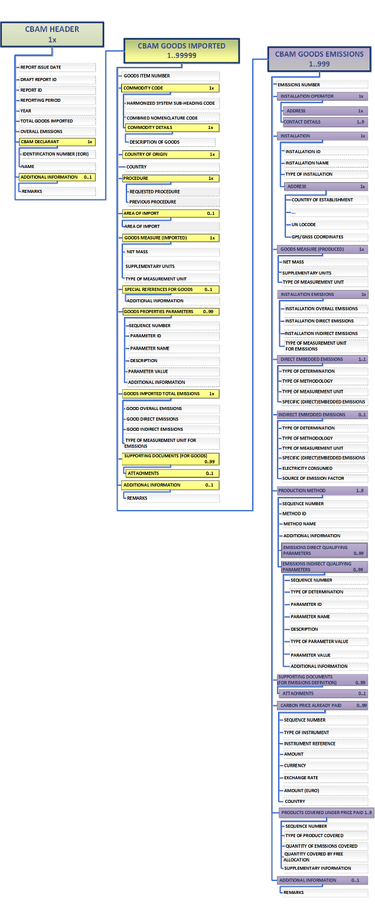
CBAM Quarterly Report Data Model

Slide 16
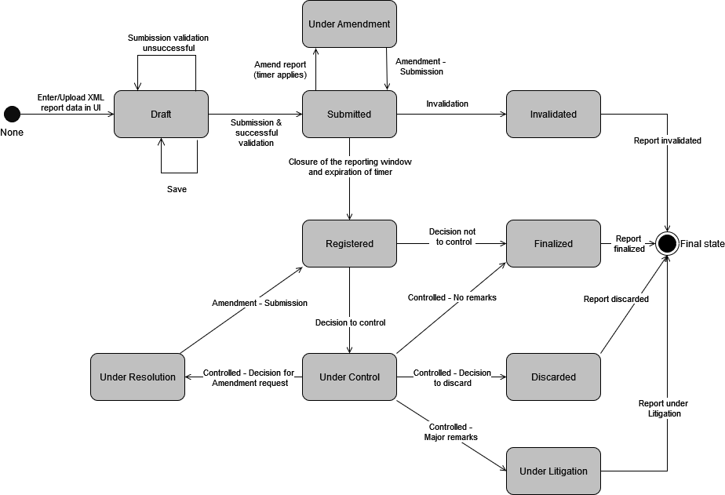
CBAM State transition diagram of CBAM Report

Slide 17
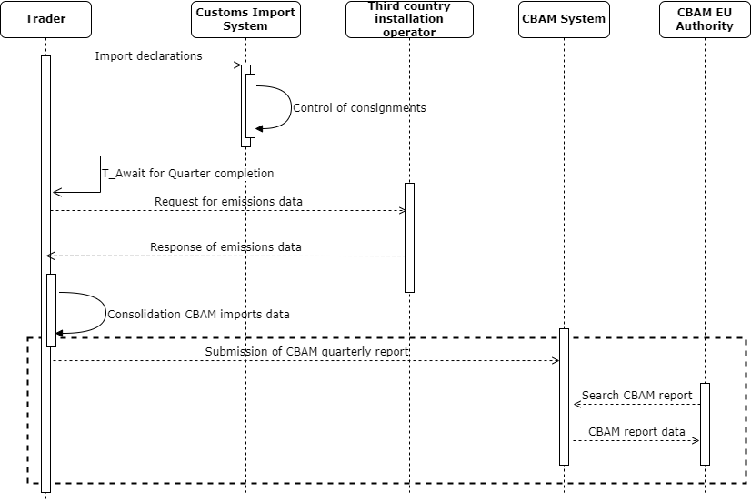
CBAM Process Model High level overview
R1

Slide 18
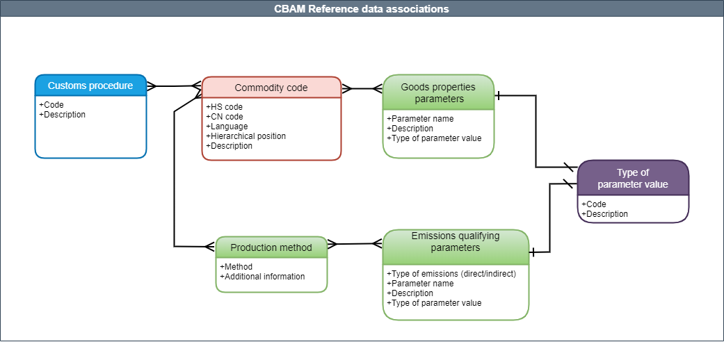
CBAM Reference data associations

Slide 19
Thank you! Do you have any questions?
© European Union 2022

