Slide 1


OECD ECONOMIC SURVEY OF THE CZECH REPUBLIC
30 March 2023, Prague
Towards a strong and sustainable recovery
@OECD
@OECDeconomy
oe.cd/czech-rep

Slide 2
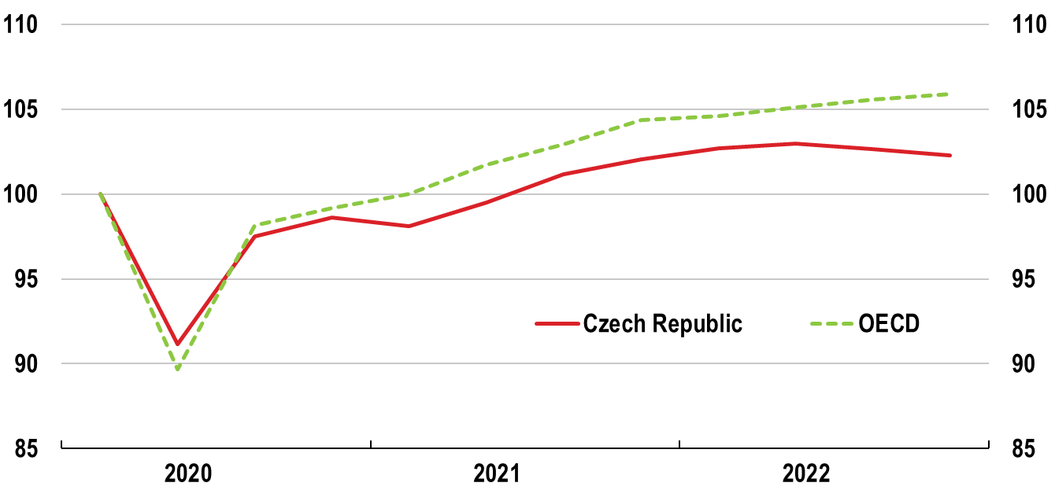
Russia’s war of aggression has disrupted the post-pandemic recovery
Real GDP
2020 Q1 = 100
Source: OECD Economic Outlook database.

Slide 3
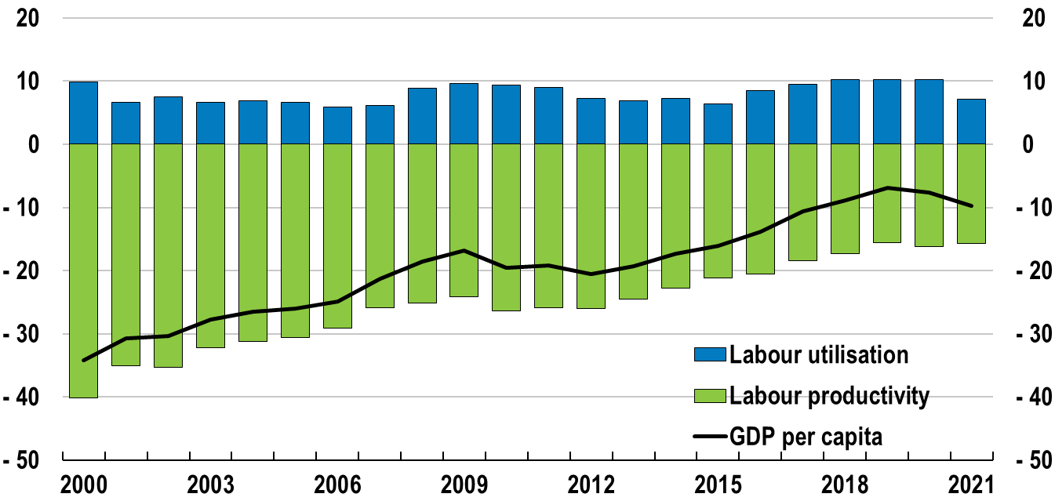
Progress towards OECD average incomes has been disrupted
GDP per capita
% pts difference with respect to the OECD
Note: GDP is measured by GDP at current prices, current PPPs. Labour productivity is measured by GDP per hour worked and labour utilisation is the total number of hours worked divided by the population.
Source: OECD Productivity database.

Slide 4
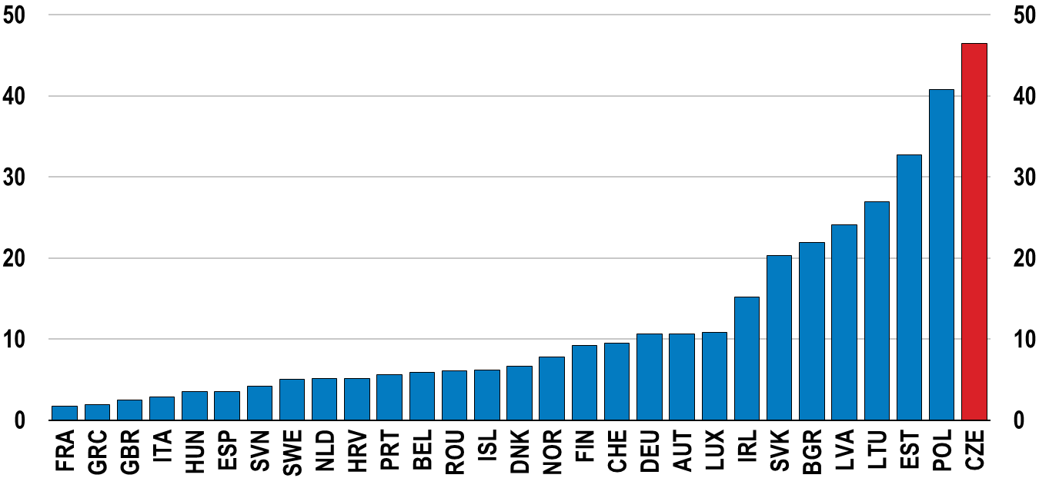
The Czech Republic has welcomed the largest (per capita) number of Ukrainian refugees
Number of refugees from Ukraine registered for Temporary Protection or similar national protection schemes
Per thousand population
Note: last updated 7 March 2023.
Source: OECD calculations based on UNCHR, Operational data portal.

Slide 5
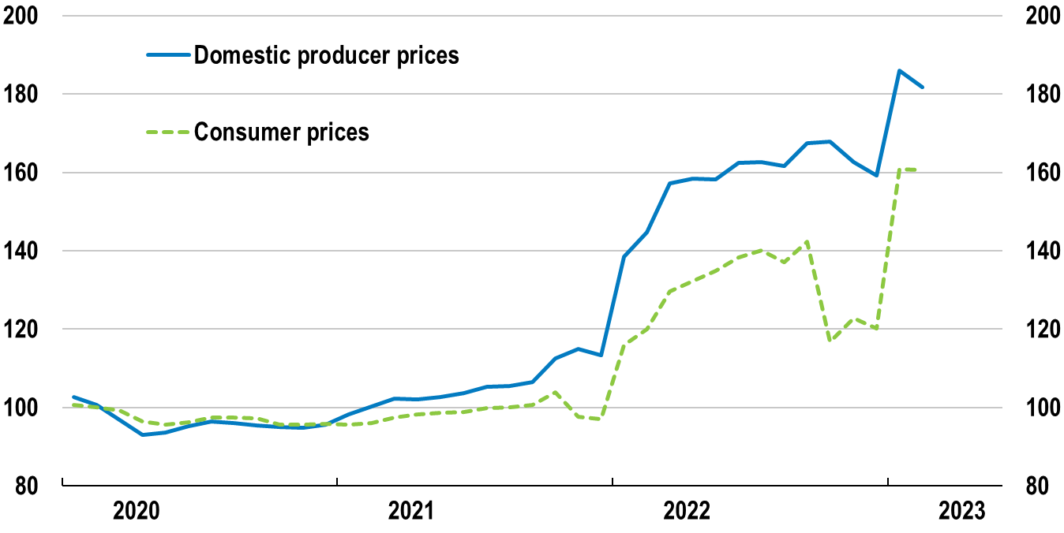
Energy prices have surged
Energy prices
Index 2020 Q1 = 100
Source: OECD Consumer and Producer prices indices.

Slide 6
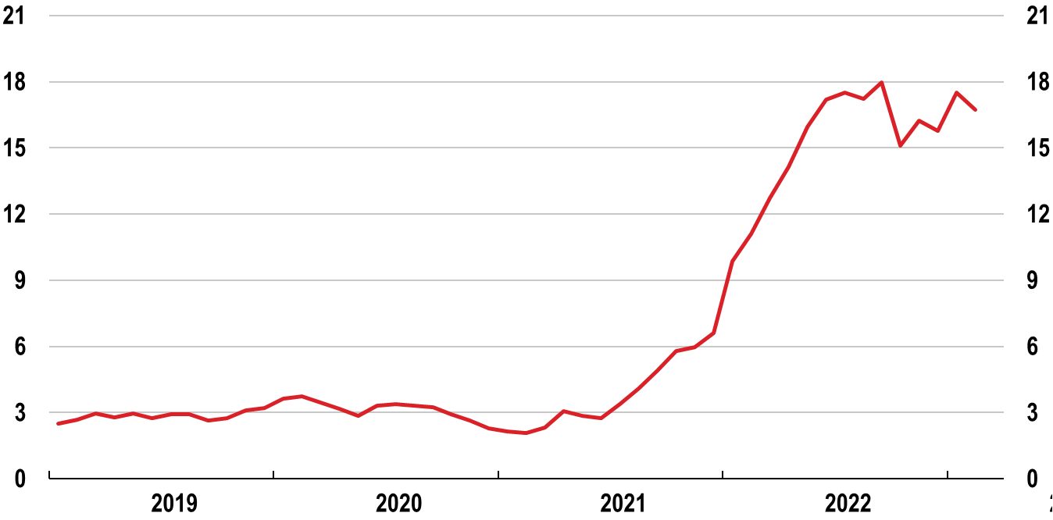
Inflation is high
Consumer price index
Y-o-y % changes
Source: Czech Statistical Office; OECD Prices database.

Slide 7
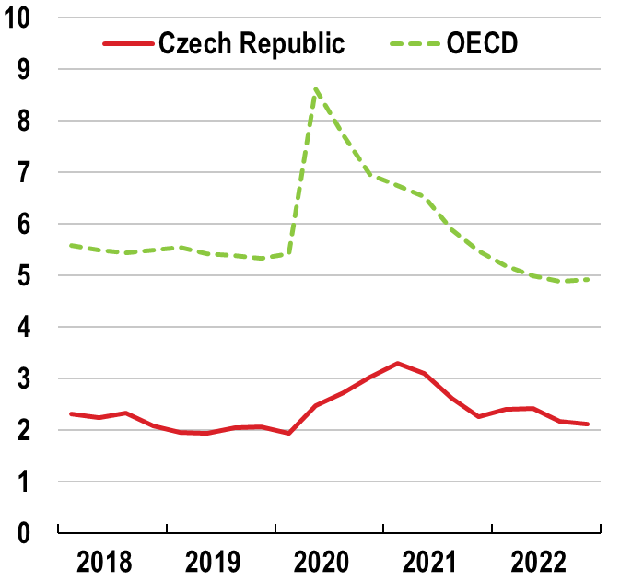
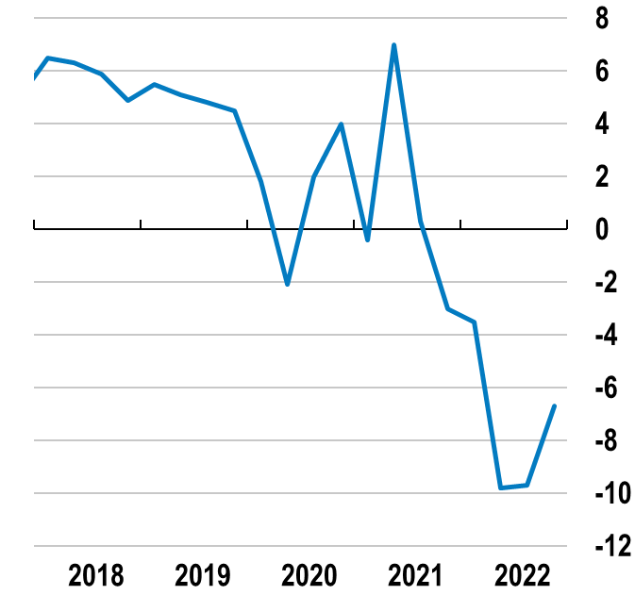
Unemployment remains low, but real wages have fallen steeply
Unemployment rate
% of labour force
Real wages
Y-o-y % changes
Source: OECD Economic Outlook database; Czech Statistical Office.

Slide 8
Growth will be subdued in 2023
 | 2022 | 2023 | 2024
Real GDP growth, % | 2.4 | 0.1 | 2.4
Unemployment rate, % | 2.3 | 2.6 | 2.8
Consumer price inflation, % | 15.1 | 13.0 | 4.1
Fiscal balance (% of GDP) | -3.8 | -4.3 | -3.7
Source: OECD calculations based on OECD Economic Outlook 112 database.

Slide 9
A tight macro policy stance and
a credible fiscal consolidation plan are needed

Slide 10
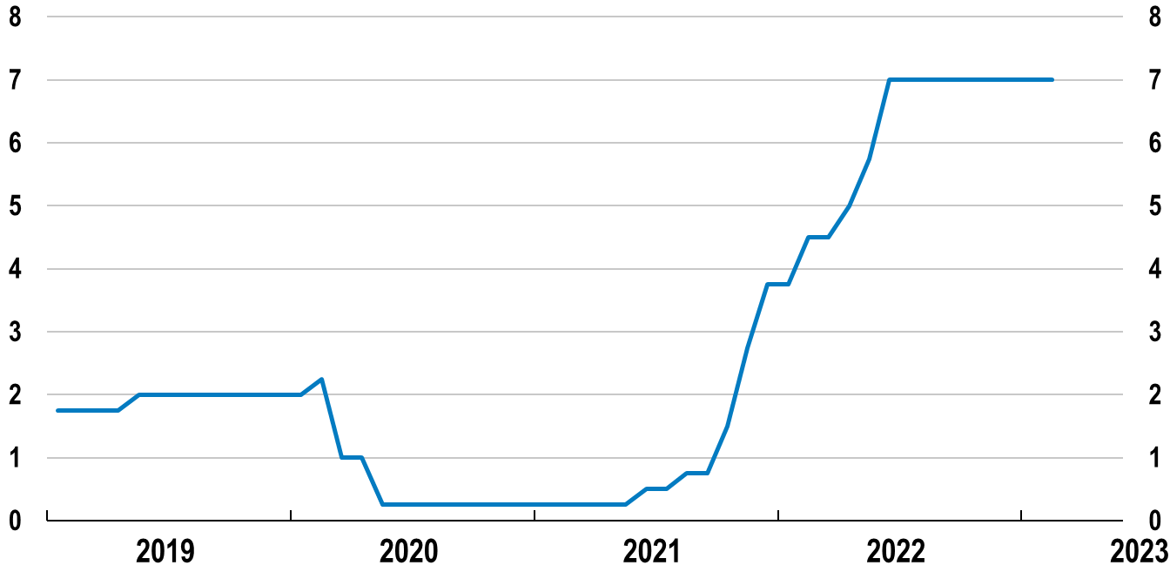
Monetary policy has been tightened significantly
Policy rate
Two-week repo rate, %
Source: Refinitiv.

Slide 11
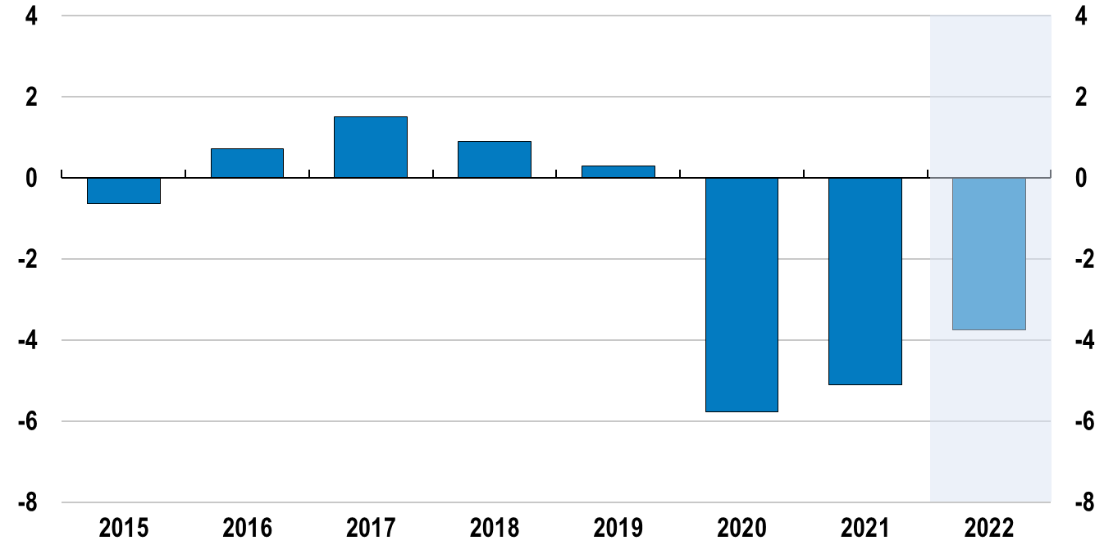
Fiscal balances have deteriorated
Government’s budget balance
% of GDP
Source: OECD Economic Outlook database.

Slide 12
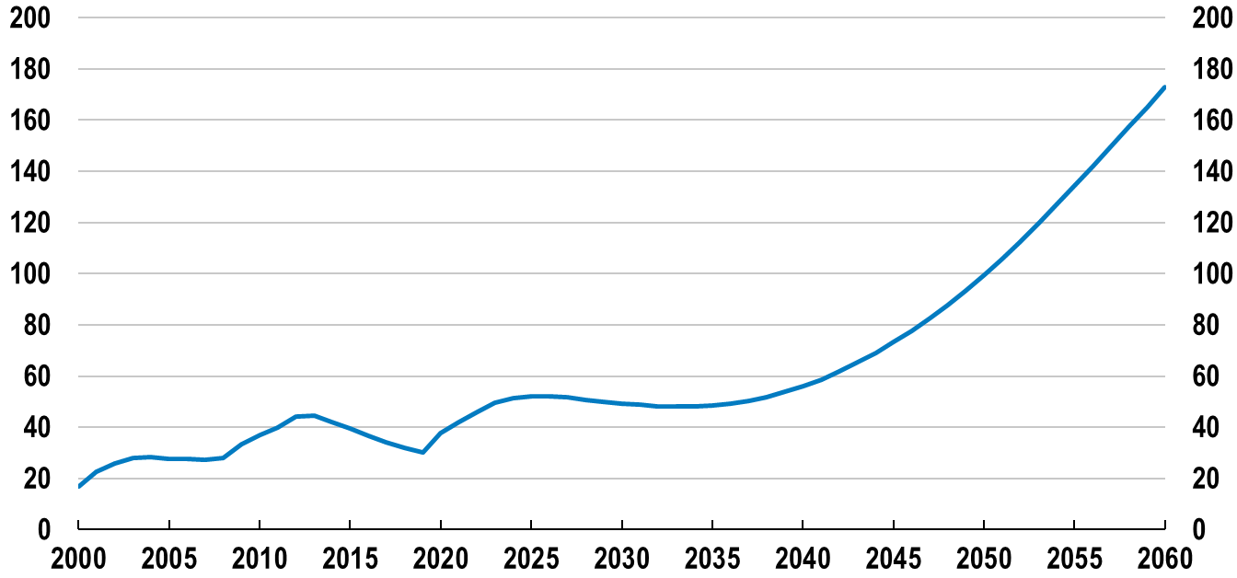
Pressures from population ageing threaten fiscal sustainability
Government gross debt
Scenario under existing policies, % of GDP
Note: The projections are illustrative.
Source: OECD calculations.
Notes:
Note: Simulations are based on the OECD Economics Department Long-term Model with a no policy change scenario used as the baseline. The projections are illustrative. The OECD Long-term model considers demographics but also the Baumol effect – i.e., the tendency for the relative price of services to increase over time. It is also assumed that other primary expenditures (other than health and pensions) are affected by ageing. The assumption is that governments would seek to provide a constant level of services in real per capita terms. This translates into higher fiscal pressure when the employment / population ratio falls. In addition, the scenarios assume that public pensions will grow roughly at the pace of wages, keeping average benefit ratio constant (Guillemette and Turner, 2021). The line assumes that rising ageing costs are financed with deficits.

Slide 13
Czech workers retire early
Average effective age of labour-market exit, 2020
Note: Effective labour market exit age is shown for the six‑year period 2015‑20.
Source: OECD (2021), Pensions at a Glance 2021.

Slide 14
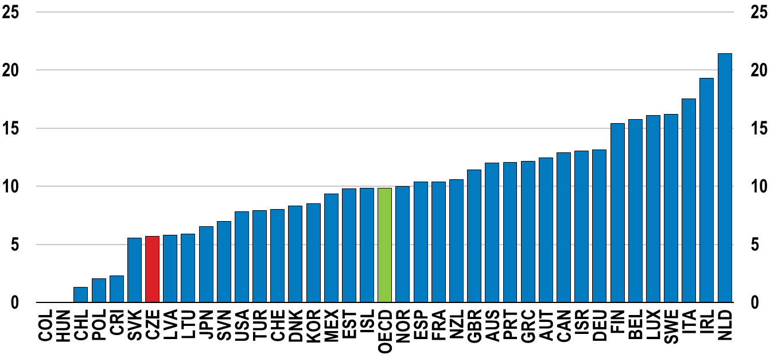
Personal income tax could be more progressive
Structural progressivity indicator
% points, 2021
Note: The structural progressivity indicator measures the percentage point change of the average income tax rate for a single person with no children if their income increases from 67% to 167% of the average wage.
Source: OECD Taxing Wages database.

Slide 15
Bringing more skilled people
to the labour market

Slide 16
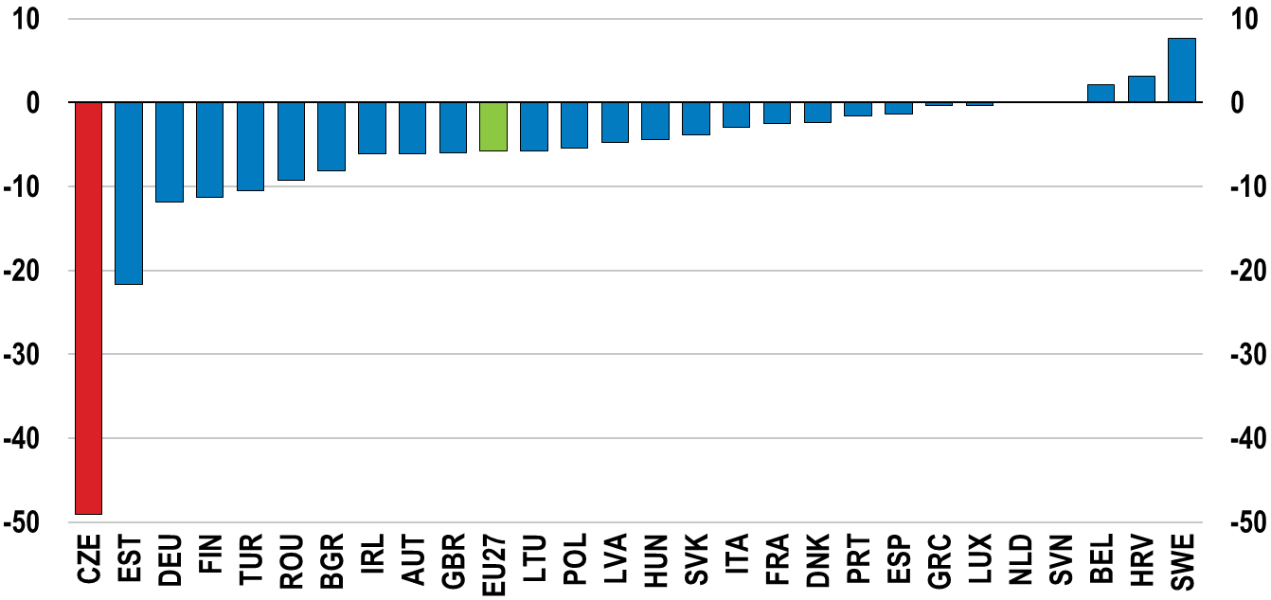
Female employment falls significantly after childbirth
Employment gap between mothers¹ and women without children
% points, 2021
1. With one child under 6 years-old.
Source: Eurostat database.

Slide 17
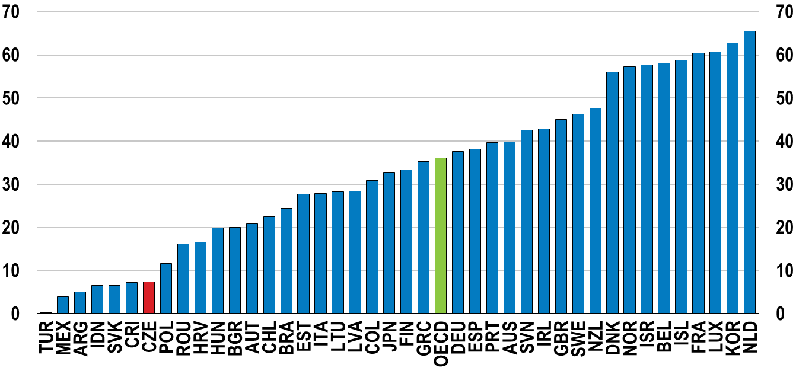
Few children under three are enrolled in childcare
Children enrolled in early childhood education and care services
0 to 2-year-olds, %, 2019 or latest available year
Note: Data generally include children enrolled in early childhood education services (ISCED 2011 level 0) and other registered ECEC services.
Source: OECD Family database, http://www.oecd.org/social/family/database.htm

Slide 18
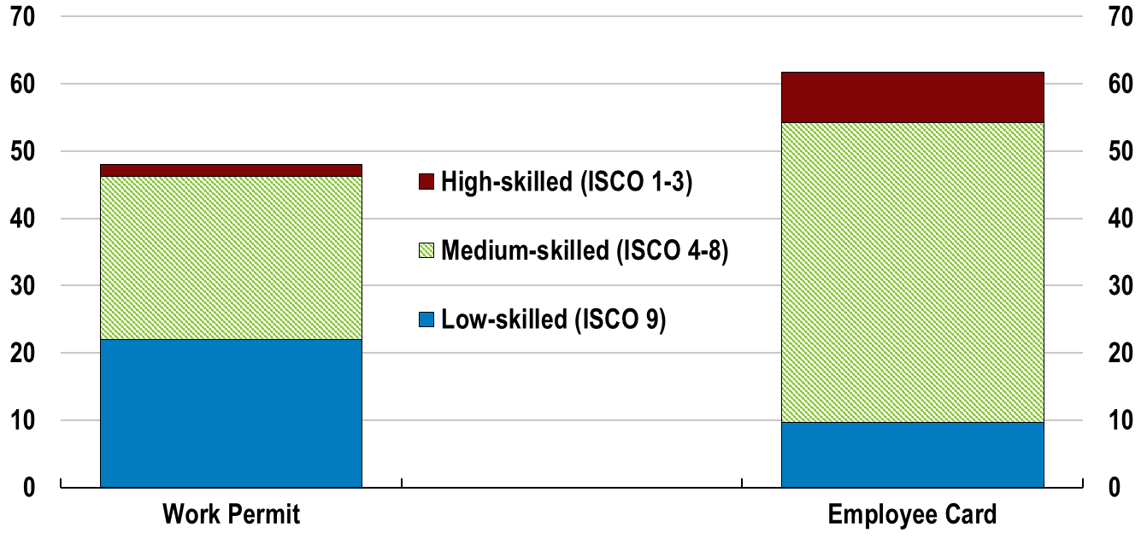
Most foreign non-EU workers hold low- to medium-skilled jobs
Active contracts for third country nationals
By occupations (ISCO), thousands, 2019
Note: Work permits are for short-term contracts, with a visa for a stay of up to 90 days. Employee card includes work and residence permit.
Source: OECD (2022), Recommendations for a Multi-criterial Points-Based Migration System for the Czech Republic, www.oecd.org/migration/mig/multicriterial-points-based-system-for-managing-labour-migration-to-the-czech-republic.htm.

Slide 19
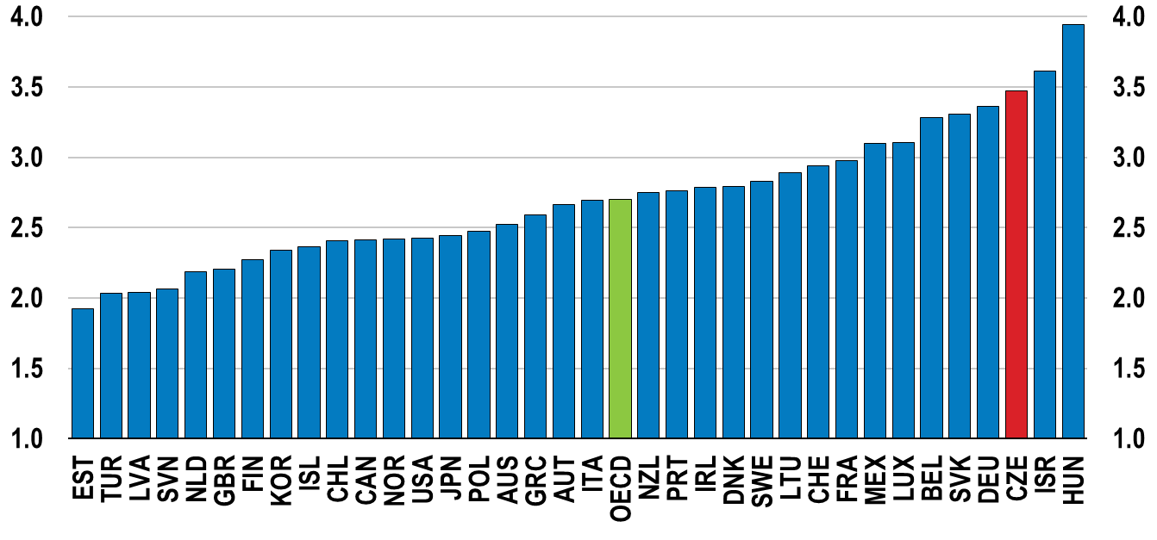
Inequalities in education should be further addressed
Likelihood of low performance among disadvantaged students, relative to non-disadvantaged students, odds ratio
Note: A socio-economically disadvantaged student is a student in the bottom quarter of ESCS (PISA index of economic, social and cultural status) in his or her own.
Source: OECD (2019), PISA 2018 Results (Volume II): Where All Students Can Succeed, PISA, OECD Publishing, Paris, https://doi.org/10.1787/b5fd1b8f-en.

Slide 20
Reducing greenhouse
gas emissions

Slide 21
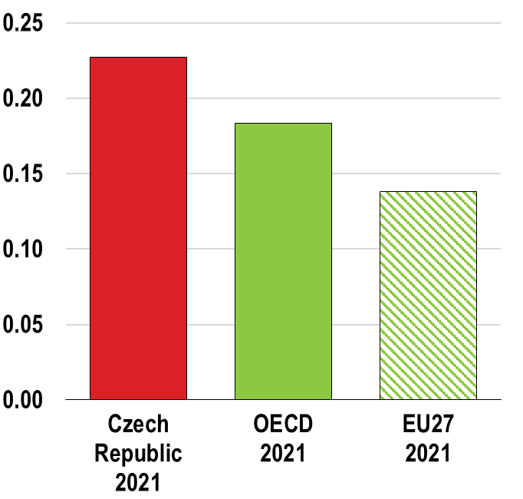
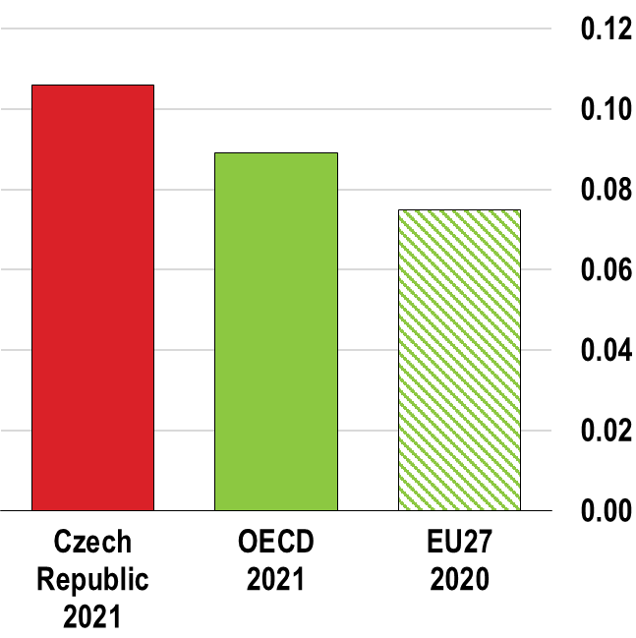
There is ample room to reduce greenhouse gas emissions
CO2 intensity
CO2 per unit of GDP, kg/USD
Energy intensity
Energy supply per unit of GDP, ktoe/USD
Source: OECD Green Growth Indicators; IEA World Energy Statistics and Balances.

Slide 22
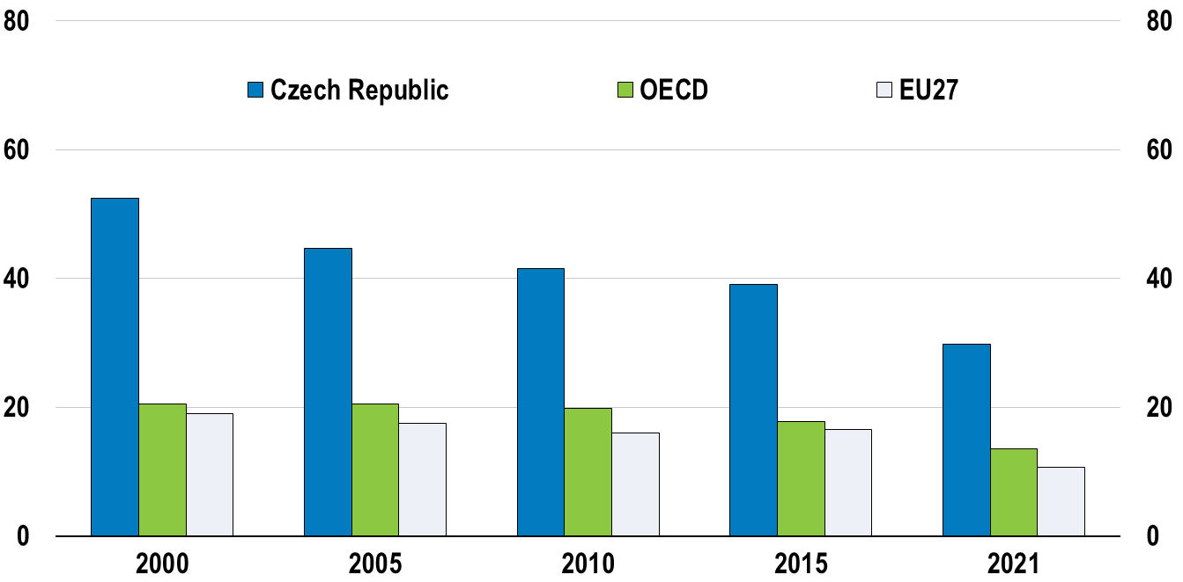
Reliance on coal remains very high
Energy mix
Share of coal in total energy supply, %
Source: IEA (2022), IEA World Energy Statistics and Balances.

Slide 23
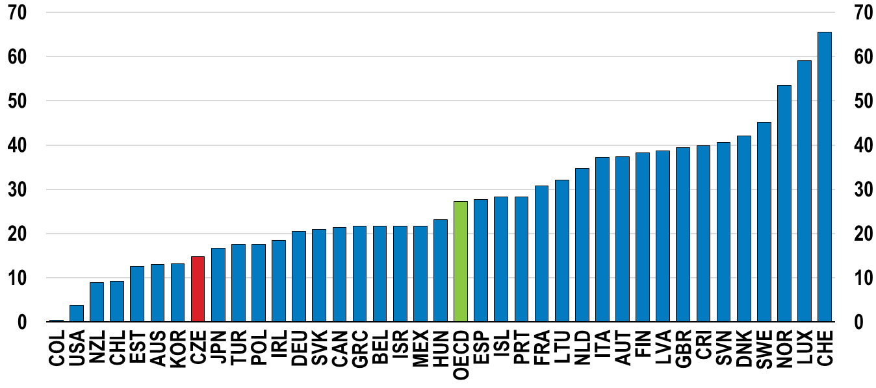
Effective carbon tax rates are among the lowest in the OECD
Percentage of GHG emissions subject to a positive Net Effective Carbon Rate (ECR), 2021
At above EUR 60 per tonne of CO2e
Note: OECD is a simple arithmetic average.
Source: OECD (2022), Pricing Greenhouse Gas Emissions: Turning Climate Targets into Climate Action, OECD Series on Carbon Pricing and Energy Taxation, OECD Publishing, Paris

Slide 24
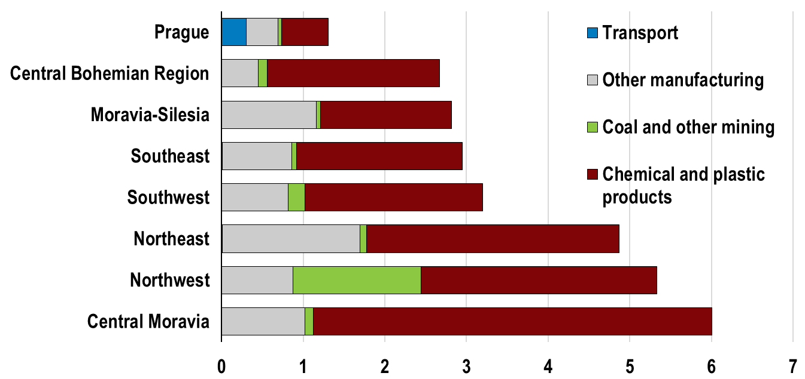
Labour reallocation will continue with some regions and sectors more at risk
Share of jobs at risk of job losses related to climate mitigation
% of total regional employment, 2019
Source: Eurostat database; OECD Regional Statistics database.

Slide 25
Public governance review of the czech republic

Slide 26
Fragmented territorial and municipal administrations undermine policy co-ordination
Municipality sizes, OECD and EU (number of inhabitants, 2020)
228,801
^
1,710
Source: OECD (2021), Subnational governments in OECD countries: Key data (brochure), OECD, Paris, www.oecd.org/regional/regional-policy ; Database: http://dx.doi.org/10.1787/region-data-en
Notes:
The public administration faces shortcomings in its strategic, human and digital capabilities at all levels of government to meet the current challenges

Slide 27
The Czech Republic’s public administration is moderate in size
Relative size and centralization of public administration, 2019
OECD Average
OECD Average
Source: OECD (2021), Government at a Glance.

Slide 28
Opportunities for a more effective and better coordinated public administration
REFORM AREA
OVERVIEW OF KEY RECOMMENDATIONS
PAR Strategy
1. Ensure that the public administration reform 2030 strategy (PAR) has sufficient leadership, support and resources for effective implementation
Strategic planning
2. Further develop the role of Office of the Government to improve alignment and delivery on strategic objectives and planning processes
Multi-level governance
3. Provide incentives to foster intermunicipal cooperation and increase multi-level coordination through new bodies and instruments
Public service
4. Strengthen the attractiveness of the public service to recruit talent
Notes:
The OECD Public Governance Review highlights the need for a more effective public administration to tackle the policy challenges on the horizon and deliver better public services

Slide 29




For more information
OECD Economics
OECD Public Governance
OECD
Disclaimers:
The statistical data for Israel are supplied by and under the responsibility of the relevant Israeli authorities. The use of such data by the OECD is without prejudice to the status of the Golan Heights, East Jerusalem and Israeli settlements in the West Bank under the terms of international law.
This document and any map included herein are without prejudice to the status of or sovereignty over any territory, to the delimitation of international frontiers and boundaries and to the name of any territory, city or area.
oe.cd/czech-rep
https://doi.org/10.1787/22190414

