Slide 1
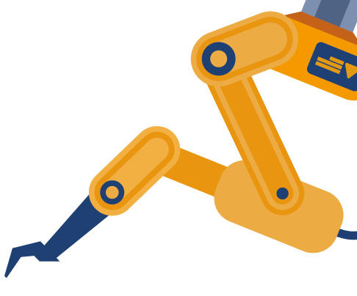
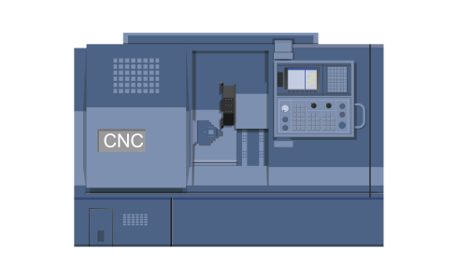
February 21, 2022
Are you looking for the Best Machinery Suppliers?
Sourcing TAIWAN 2022 - Machinery is your best opportunity! It's the 1st time we work with the 3rd largest machinery expo TIMTOS x TMTS to bring you the best machinery suppliers in Taiwan.
Save Time on Sourcing
Get a email list of recommended suppliers based on your preference
Meet Suppliers without Travel
Assist you to schedule an online meeting with your potential suppliers
If you need any further information, please do not hesitate to contact
Attila Gál – Cztwec01@moea.gov.tw
Nancy Li – Cztwec02@moea.gov.tw
Organized by |
Implemented by |
Bureau of Foreign Trade,
MOEA
Taiwan External Trade
Development Council
Precision Machinery
Research & Development Center

